Slide 1

Unit-6 Arduino and Raspberry Pi
IOT and Applications
GTU # 3160716
Prof. Tushar J. Mehta
Computer Engineering Department
tushar.mehta@darshan.ac.in
8866756776

Slide 2
Arduino
Section - 1

Slide 3
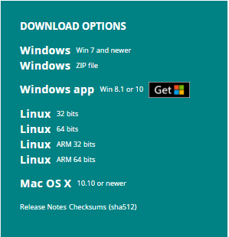
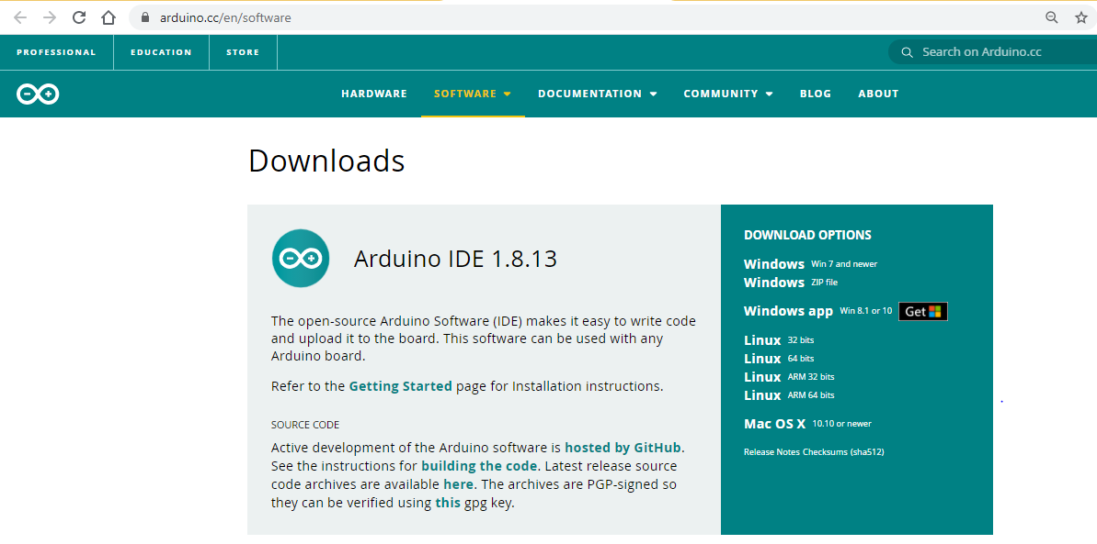
Programming the Arduino
Programming of Arduino is done in Arduino IDE – Integrated Development Environment.
The software helps to connect, upload and communicate with Arduino hardware.
The Arduino software is an open-source platform.
The steps to install the Arduino software into the computer are as following:
Download Arduino IDE from http://arduino.cc/en/Main/Software

Slide 4
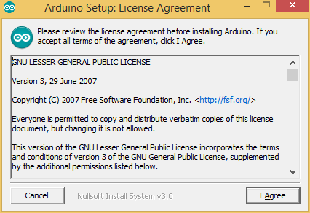
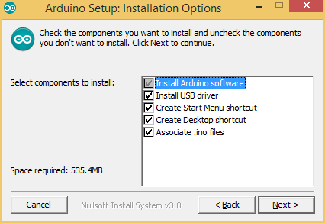
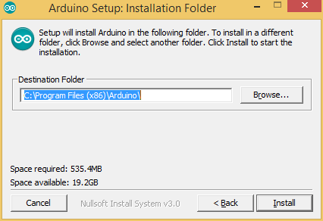
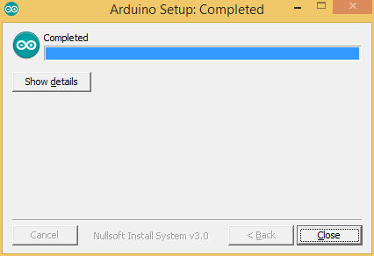
Installation process of Arduino
After downloading the installer double click and install the software by agreeing to License Agreement.
Select the components required to be installed and click on next. Make sure to have free space in hard drive which is mentioned in the software.
Select the path where you want to install Arduino IDE and click on “Install”
Now wait for few minutes until installation process gets completed.
The dialogue box will show the “Completed” status of the installation. Click on “Close” button.

Slide 5
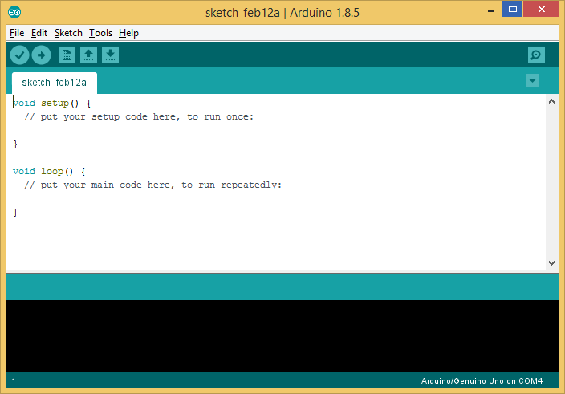
Arduino IDE Explanation
Open Arduino IDE software. Here, we can find different sections.
Editor – It is the space where we can write the code
A text Console – for displaying the messages.
A toolbar with buttons – given for common functions to perform.
Menu bar – A menu bar with series of menus
Note that, the name of the default file is sketch_[currentdate] with the alphabet ‘a’ and every new file has consecutive alphabet.
4
3
1
2

Slide 6
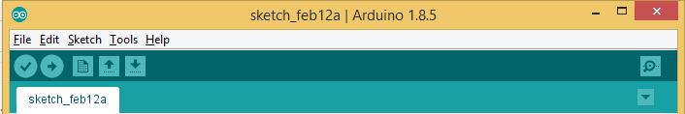
Arduino IDE Explanation – Cont.
The functions of buttons in toolbar can be explained as following:
Verify
Checks your code for errors compiling it.
Open
Presents a menu of all the sketches in your sketchbook. Clicking one will open it within the current window overwriting its content.
Upload
Compiles your code and uploads it to the configured board.
Save
Saves your sketch.
New
Creates a new sketch.
Serial Monitor
Opens the serial monitor.

Slide 7
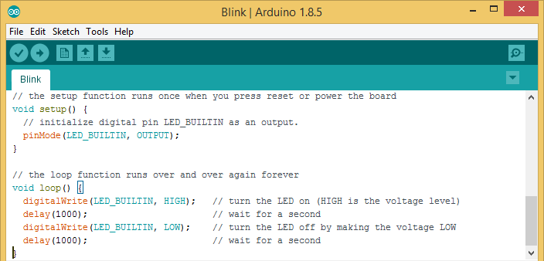
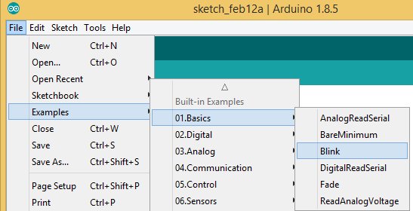
Programming the First Code
The IDE is already loaded with few basic examples. Let us take a basic example of LED blinking which blinks built-in LED of Arduino UNO with a 1-second interval.
Go to File > Examples > 01.Basics > Blink as shown in the figure.
It will load the prewritten example in a new window with the title “Blink”.

Slide 8
Code Explanation
Blink.ino
1
2
3
4
5
6
7
8
9
void setup() {
pinMode(LED_BUILTIN, OUTPUT);
}
void loop() {
digitalWrite(LED_BUILTIN, HIGH);
delay(1000);
digitalWrite(LED_BUILTIN, LOW);
delay(1000);
}
Initialize digital pin LED_BUILTIN which is at pin 13 as an output.
turn ON the LED by writing HIGH voltage level
A delay of 1000ms = 1 sec
turn OFF the LED by writing LOW voltage level
A delay of 1000ms = 1 sec
We should initialize the pin as input or output once only. Therefore the syntax for defining the pin as output is written in void setup ( ) function.
For blinking of LED, the LED should turn on and off at the regular interval of time. Hence, the instructions for turning on, turning off and delay for both on time and off time are written in the void loop ( ) function

Slide 9
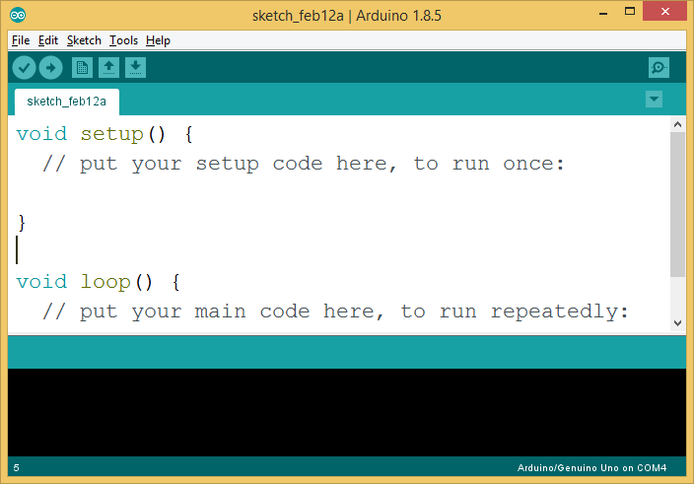
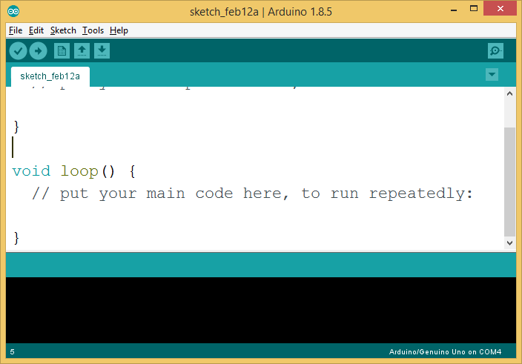
Code Explanation
Arduino code is always written with two mandatory functions.
void setup ( )
void loop ( )
The instructions which are to be performed once in the program are written in void setup ( ) function.
The instructions written in void loop ( ) are executed infinite times until the next restart of Arduino board.
Comments are important for any programming language. They are ignored while execution of the program
Anything written after // in Arduino program is considered as a single line comment
Anything written between /* and */ is considered as multiple line comments.

Slide 10
Functions in Arduino IDE
pinMode( ): Configures the specified pin to behave either as an input or an output.
Syntax : pinMode(pin, mode)
Parameters :
pin: the Arduino pin number to set the mode of.
Mode: INPUT or OUTPUT
digitalWrite( ) : Write a HIGH or a LOW value to a digital pin.
Syntax : digitalWrite(pin, value)
Parameters :
pin : the Arduino pin number.
Mode : HIGH or LOW
What is HIGH or LOW?
HIGH: - Also considered as Logic ‘1’ or Logic High. It will set 5V on the configured pin of Arduino.
LOW: - Also considered as Logic ‘0’ or Logic Low. It will set 0V on the configured pin of Arduino.

Slide 11
Functions in Arduino IDE (Cont.)
delay( ): It pauses the program for the amount of time (in milliseconds) specified as the parameter. For example, if we want to hold the program for 1 second before executing the next instruction. A delay of 1000ms = 1s is passed in the parameter.
Syntax : delay(ms)
Parameters :
ms: the number of milliseconds to pause

Slide 12
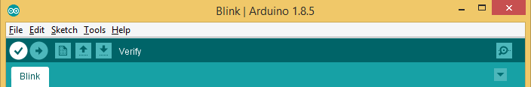
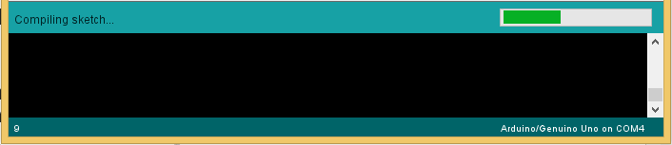
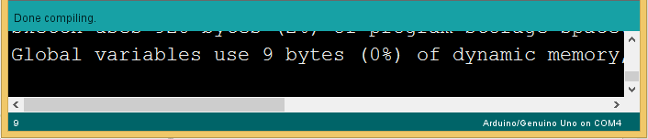
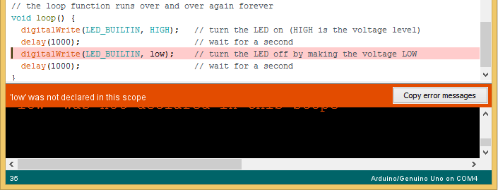
Compiling the Code
To compile a code in Arduino click on the “Verify” button in menu bar.
While compiling the code, a message “Compiling sketch” is shown with its progress in the status bar.
If there is no error in the code, the message “Done compiling” is displayed in the status bar.
If an error is present in the code it will show the message of error with highlighted syntax where the error is present.

Slide 13
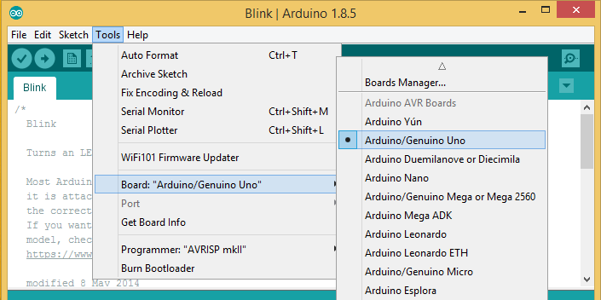
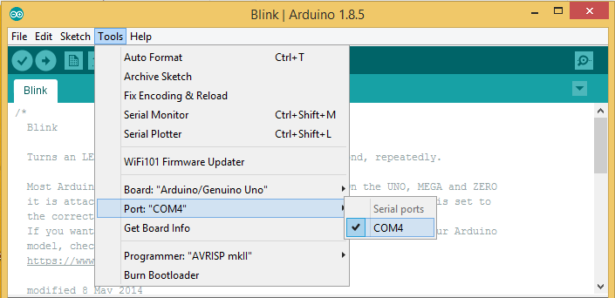
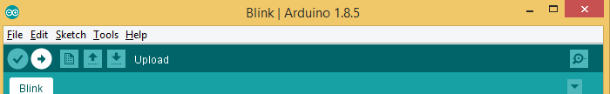
Upload the first code in Arduino Hardware
Select the proper board type: First, we need to select the appropriate board type in which we need to upload the program.
Go to Tools > Board menu and select the board which is used as the hardware.
Select port: Select the serial device of the board from the Tools > Port menu.
This is likely to be COM3 or higher (COM1 and COM2 are usually reserved for hardware serial ports).
Upload the program: Now, simply click the "Upload" button in the environment.

Slide 14
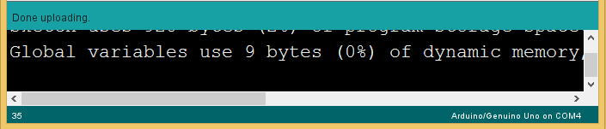
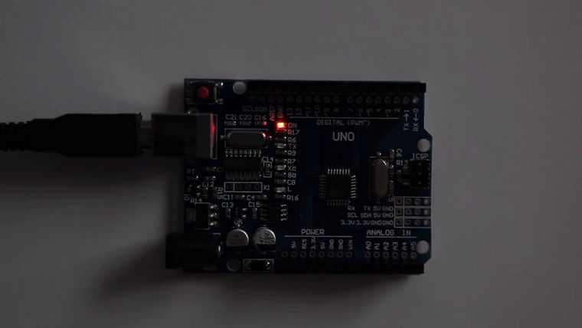
Upload the first code in Arduino Hardware
While uploading process, TX and RX LED will be flashing.
If uploading is done successfully, it will show a message “Done uploading” in the status bar.
Once the program is uploaded, the built-in LED of the Arduino board will flash with one second delay.
It means LED turns ON for 1 second and LED turns OFF for 1 second.

